Slide 1
Network Enabled Weapons – Complexities and Considerations
Justin Smith
3 - 5 September 2024 | Portsmouth University, UK
© 2024 ATEQ Consulting Ltd

Slide 2
Disclaimer(s)!
The thoughts in this presentation are entirely “personal”:
Not endorsed by any government entity
Nor is this the ‘position’ of any of our International customers
Intended to stimulate thoughts and possibly (hopefully!) debate

Slide 3
NEW – The Standards
MIL-STD-6016F Change 1 – August 2017
ATDLP-5.16(B)(1) – October 2018
Primary areas
Section 5 –
Part 2 – J11.0 / J11.1 / J11.2 Message Descriptions
Part 4 Transmit & Part 5 Receive Tables – J11.0 / J11.1 / J11.2
Appendix A – Imp Reqs (C² & NonC²)
Appendix X – NEW Transactions
Notes:
Other areas – NEW PPLI, Mission Assignments, Engagement Status/BDA Reporting, etc

Slide 4
NEW – What Is It ?
Other Controller
NOT JUST LAUNCH & CONTROL !!!
Back-Up Controller
3rd Party Information Providers

Slide 5
Participants – Network Enabled Weapon
Network Enabled Weapon
Precision Guided Missile with the ability to communicate with other network participants
In accordance with the protocols defined in Appendix X of the Standard, Transmit and Receive Tables, etc

Slide 6
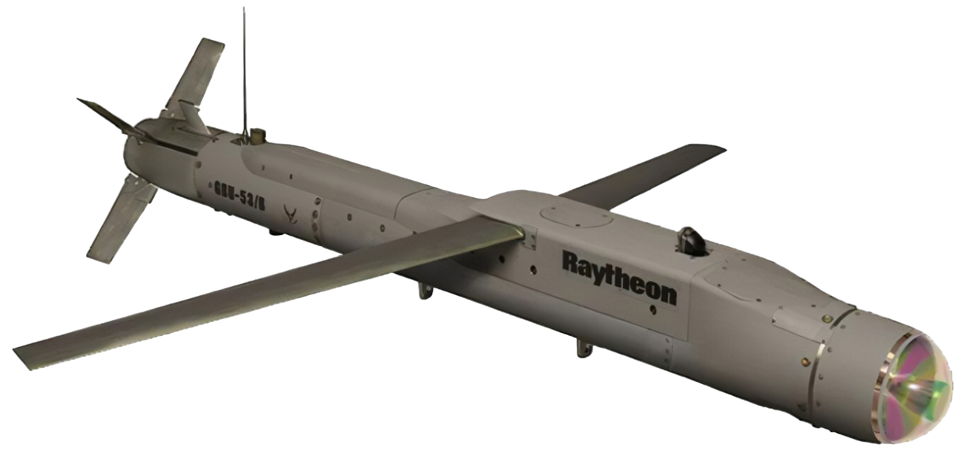
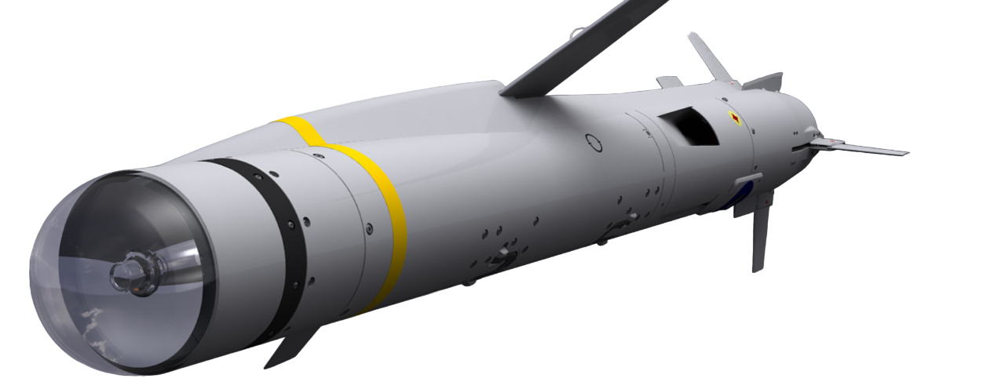
Participants – Network Enabled Weapon
Network Enabled Weapon
Notes:
MBDA – SPEAR - NETWORK ENABLED - PRECISION SURFACE ATTACK
Navair – Raytheons JSOW C1 - air-to-ground NEW capable of attacking stationary land & moving maritime targets.
Kongsberg - JSM – Joint Strike Missile
There are a variety of terminal variants (e.g. DLS TACNET, Harris BATS-E) and integration approaches (terminal or SDR)

Slide 7
Participants – Control
The current controller can also assign the weapon various third parties, authorized to communicate with the weapon
Network Enabled Weapon
Current Controller
New Controller
The current controller is a network participant, designated prior to launch and not necessarily the launch platform. It has control authority to issue directives to the assigned weapon including retargeting the weapon to a new target, providing target updates & aborting the weapon.
Current controller responsibilities may be handed off to a different network participant – a New Controller.

Slide 8
Participants – Third Party Source
The standards have growth potential to support future 3PS types. Not yet defined ?
Network Enabled Weapon
Alternate Controller
An Alternate Controller is a 3PS with whom the weapon is authorized to communicate.
IFTU 3PS
Fully Authorized
An IFTU 3PS is a 3PS who has been delegated target update authority. This IFTU 3PS has no other control authority.
- Fully Authorized IFTU 3PS
- Ping Only IFTU 3PS
Ping Only IFTU 3PS

Slide 9
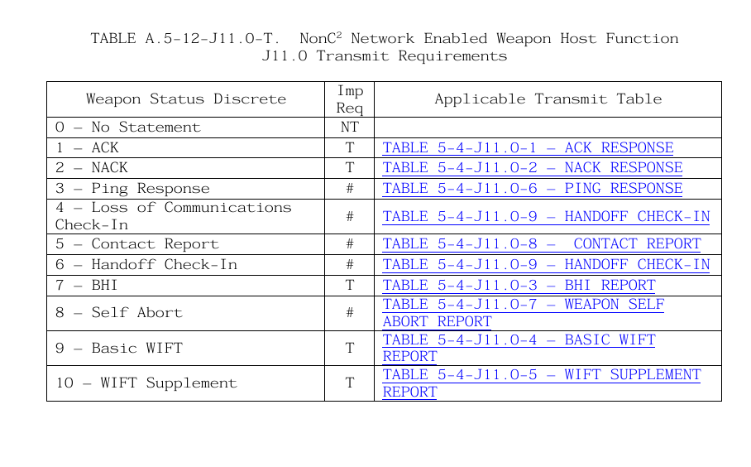
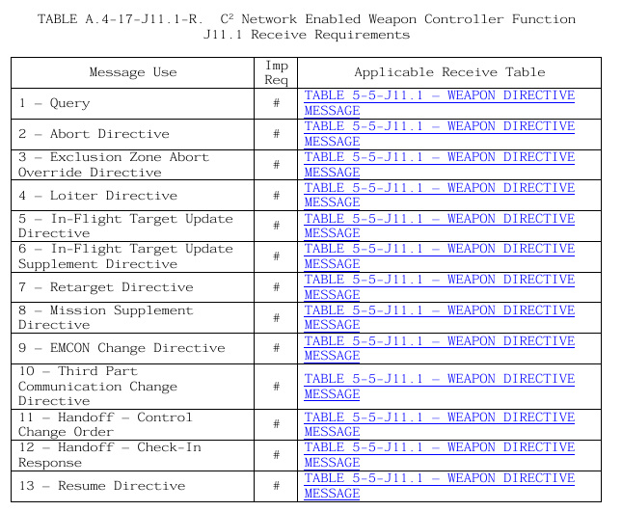
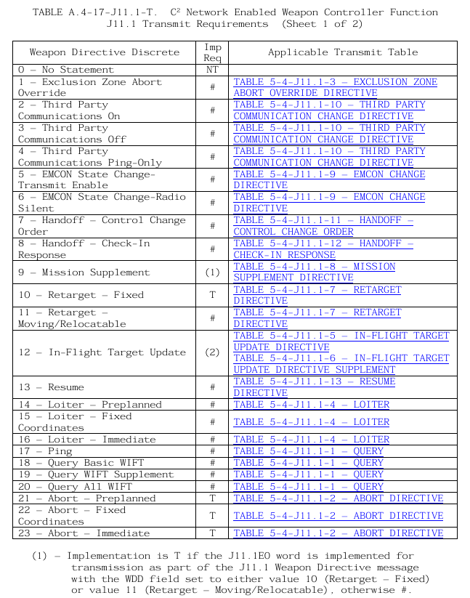
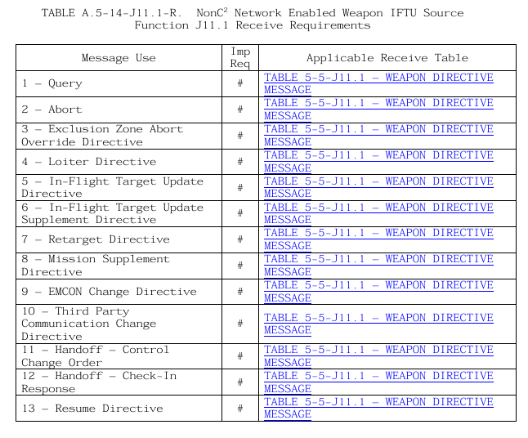
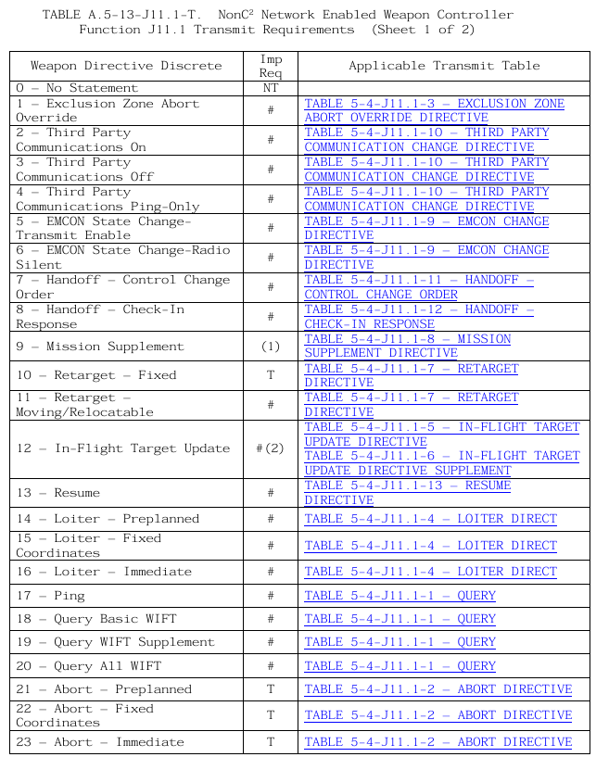
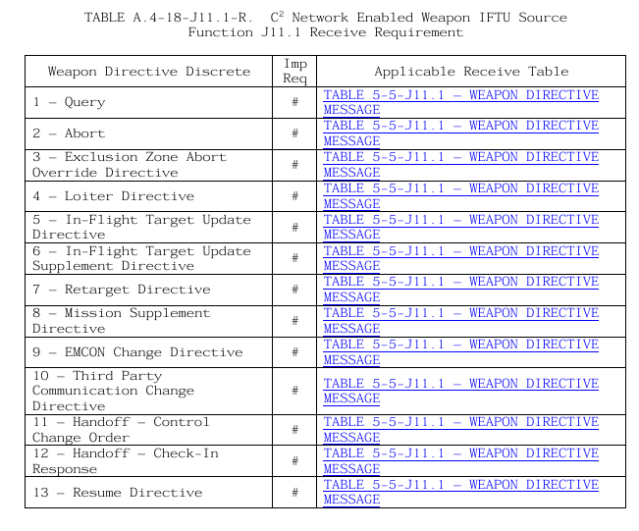
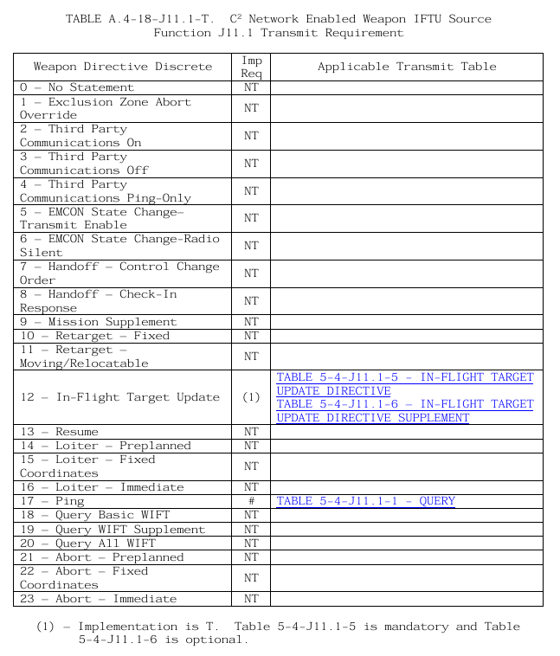
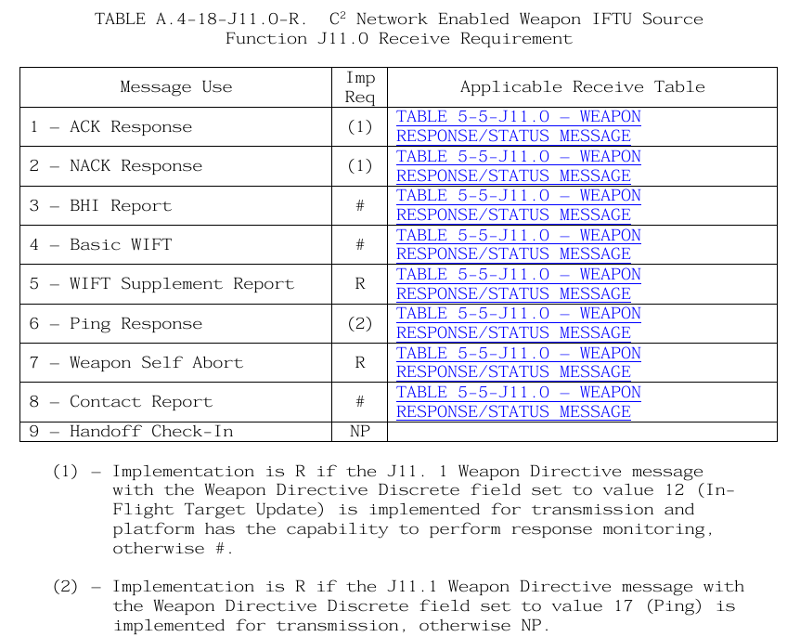
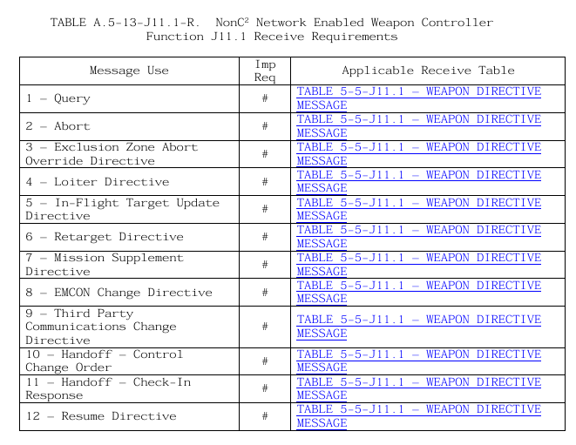
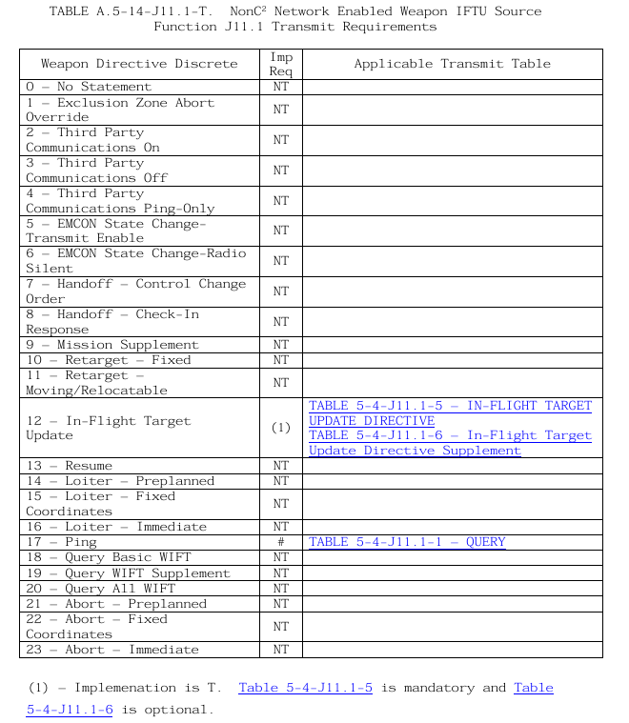
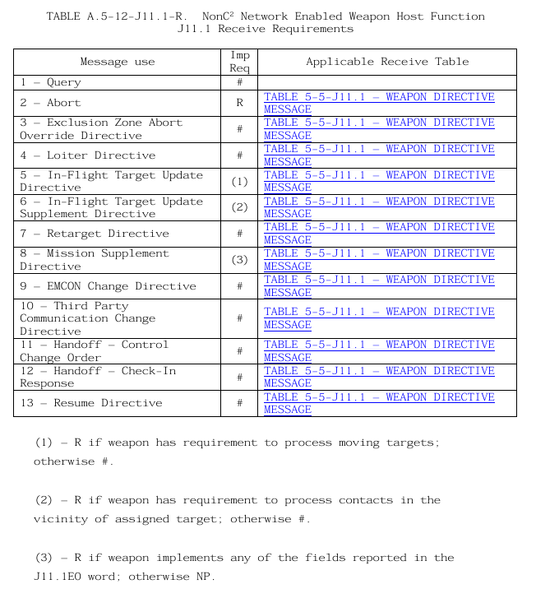
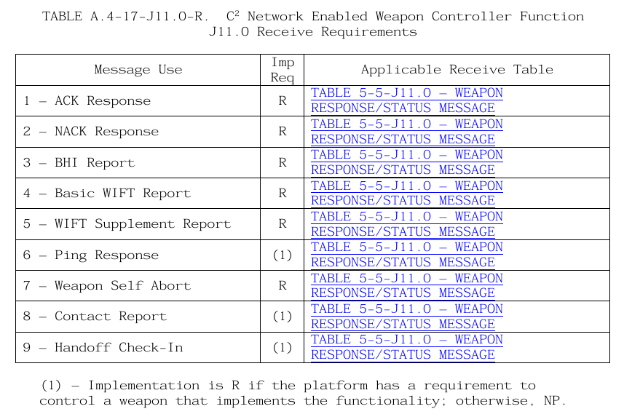
NEW – Imp Reqs

Slide 10
Missile Directives/Queries (J11.1)
Platform | Function
WIFT QUERY DIRECTIVE
RETARGET DIRECTIVE
MISSION SUPPLEMENT DIRECTIVE
LOITER DIRECTIVE (Pre-Planned, Fixed, Immediate)
RESUME DIRECTIVE
ABORT DIRECTIVE (Pre-Planned, Fixed, Immediate)
EXCLUSION ZONE ABORT OVERRIDE DIRECTIVE
EMCON CHANGE DIRECTIVE
HANDOFF CONTROL CHANGE ORDER
THIRD PARTY COMMUNICATION CHANGE DIRECTIVE
HANDOFF - CHECK-IN RESPONSE
IN-FLIGHT TARGET UPDATE DIRECTIVE
IN-FLIGHT TARGET UPDATE DIRECTIVE SUPPLEMENT
Mandated
Mandated
Mandated
Current Controller
New Controller
HANDOFF - CHECK-IN RESPONSE
Alternate Controller
HANDOFF - CHECK-IN RESPONSE
PING QUERY
Mandated
IN-FLIGHT TARGET UPDATE DIRECTIVE
IN-FLIGHT TARGET UPDATE DIRECTIVE SUPPLEMENT
Fully Authorized IFTU 3PS
Ping Only 3PS
PING QUERY

Slide 11
Missile Responses (J11.0)
Function | Platform
RETARGET DIRECTIVE RESPONSE
MISSION SUPPLEMENT DIRECTIVE RESPONSE
HANDOFF CONTROL CHANGE ORDER RESPONSE
3PS COMMUNICATION CHANGE DIRECTIVE RESPONSE
IN-FLIGHT TARGET UPDATE DIRECTIVE RESPONSE
LOITER DIRECTIVE RESPONSE
RESUME DIRECTIVE RESPONSE
ABORT DIRECTIVE RESPONSE
EZAO DIRECTIVE RESPONSE
EMCON CHANGE DIRECTIVE RESPONSE
HANDOFF - CHECK-IN
Current Controller
Optional
Optional
Optional
Optional
HANDOFF - CHECK-IN
New Controller
Optional
Optional
Alternate Controller
HANDOFF – CHECK-IN
PING QUERY RESPONSE
Optional
IN-FLIGHT TARGET UPDATE DIRECTIVE RESPONSE
Fully Authorized IFTU 3PS
Optional
PING QUERY RESPONSE
Ping Only 3PS

Slide 12
Missile Reports (J11.0)
Function | Platform
BOMB HIT INDICATION (BHI) REPORT
BASIC WEAPON IN FLIGHT TRACK (WIFT) REPORT
WIFT SUPPLEMENT REPORT
SELF ABORT REPORT
CONTACT REPORT
Current Controller
Optional
Optional
Optional
New Controller
Alternate Controller
Optional
BOMB HIT INDICATION (BHI) REPORT
BASIC WEAPON IN FLIGHT TRACK (WIFT) REPORT
WIFT SUPPLEMENT REPORT
SELF ABORT REPORT
CONTACT REPORT
Optional
Fully Authorized IFTU 3PS
Optional
Optional
Optional
Ping Only 3PS

Slide 13
Weapon Coordination (J11.2)
Function | Platform
CONTROL REQUEST FROM CURRENT CONTROLLER
CONTROL REQUEST TO CURRENT CONTROLLER
ACCEPT RESPONE
REJECT RESPONSE
HANDOFF FAILURE
New Controller
Optional
Current Controller
Function | Platform
Mandated
IFTU 3PS REQUEST FROM CURRENT CONTROLLER
IFTU 3PS REQUEST TO CURRENT CONTROLLER
ACCEPT RESPONE
REJECT RESPONSE
CEASE IFTU 3PS REQUEST FROM CURRENT CONTROLLER
IFTU 3PS
Alternate Controller
Mandated
Notes:
Control
– All optional for Tx except Accept/Reject which are Tx if any of the other message are received.
- All optional for Rx except Accept/Reject which are Rx if any of the other message are transmitted
IFTU
- All optional for Tx
- IFTU 3PS request from current controller and Cease IFTU, only mandated MUs for reception.

Slide 14
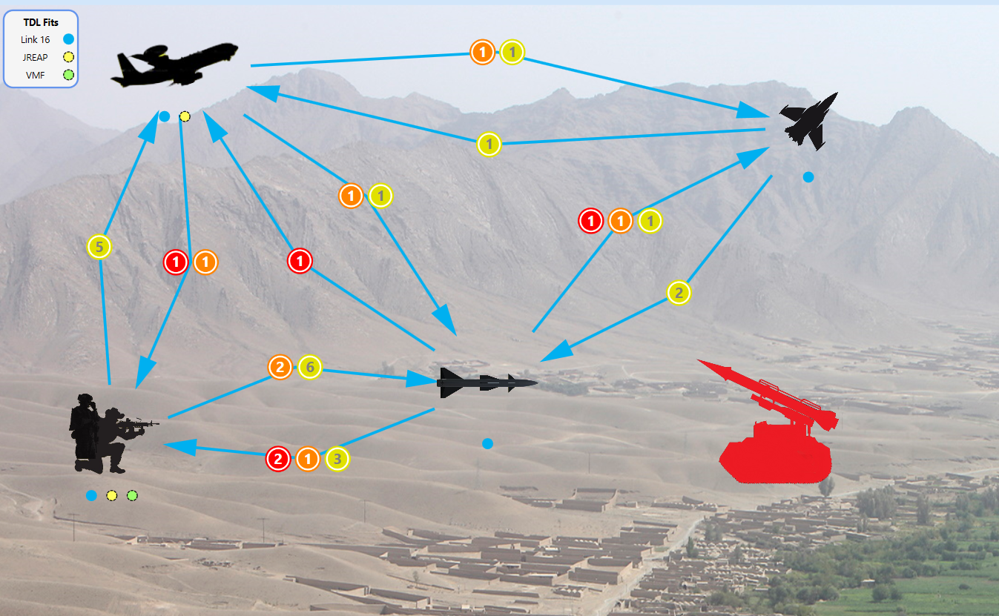
NEW – Messages in Context
J11.2
J11.1
J11.2
J11.1
J11.0
J11.2
J11.2
J11.0
J11.1
J11.1
J11.1
J11.0

Slide 15
NEW – Imp Reqs

Slide 16
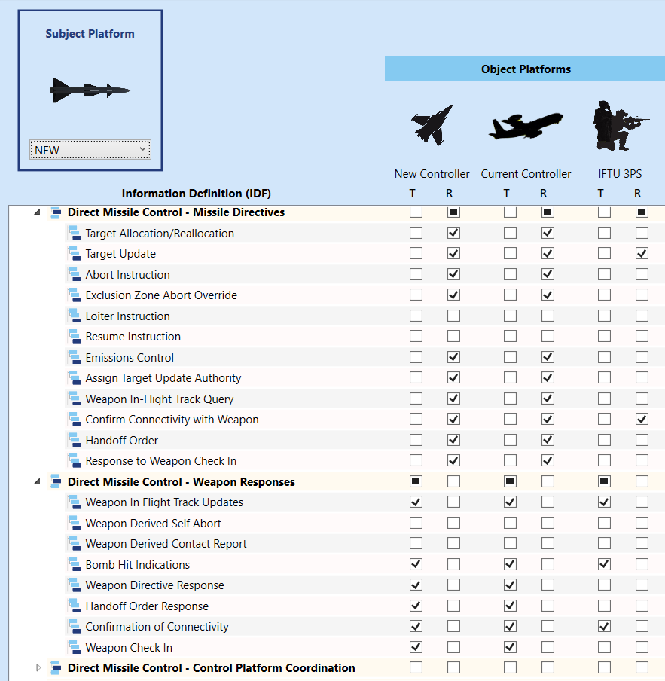
Information Exchange Requirements

Slide 17
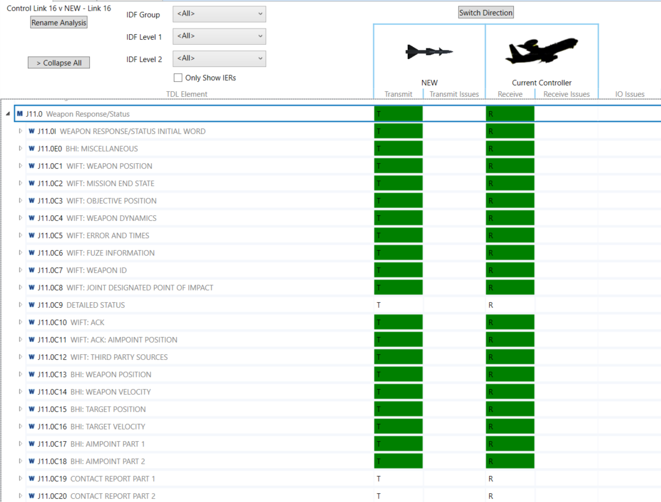
NEW – Perfect Implementation

Slide 18
NEW – Imp Reqs

Slide 19
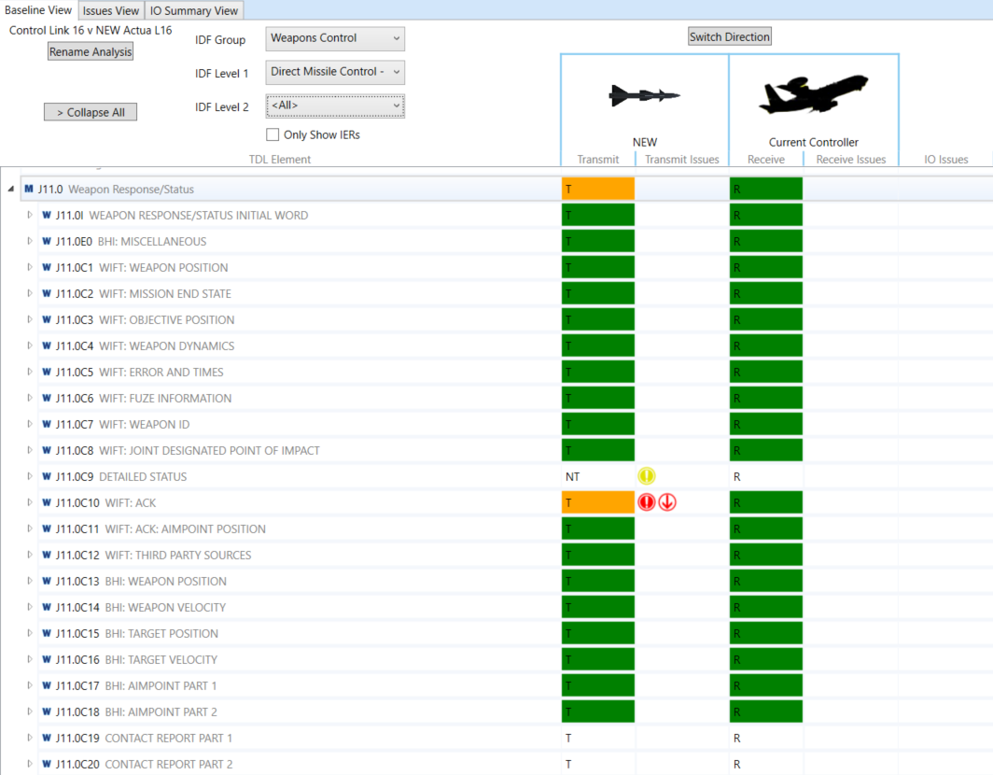
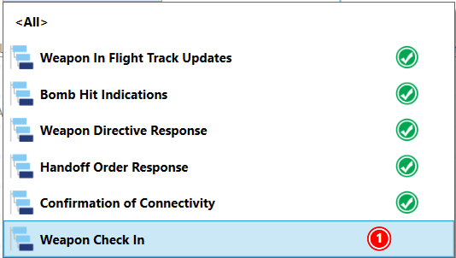
NEW – Actual Weapon Implementation

Slide 20
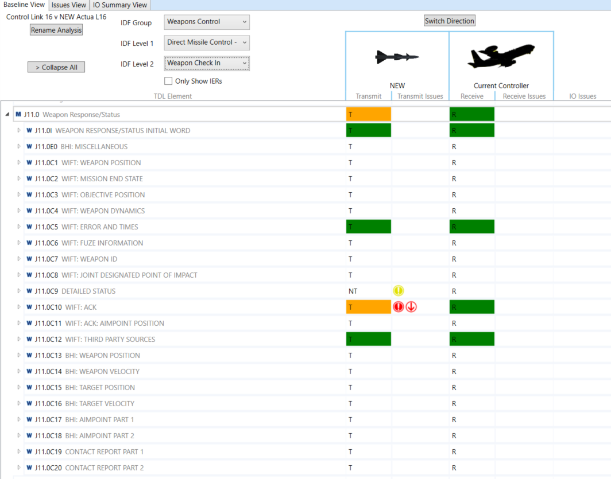
NEW – Weapon Implementation

Slide 21
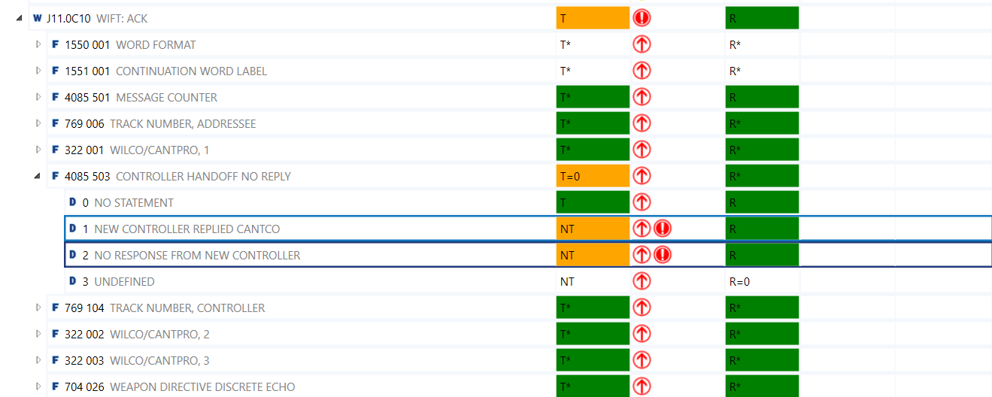
NEW – Weapon Implementation

Slide 22
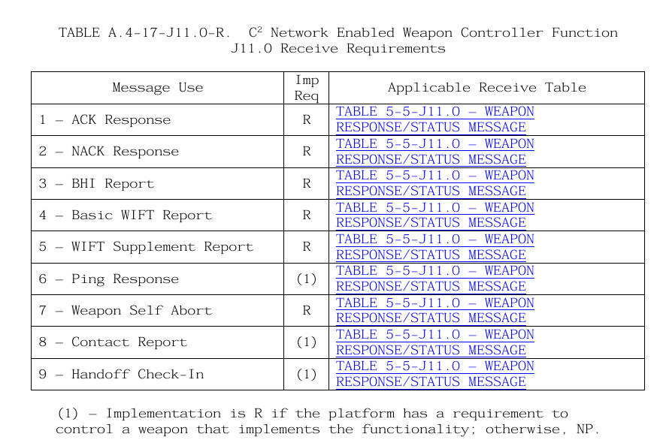
NEW – Imp Reqs

Slide 23
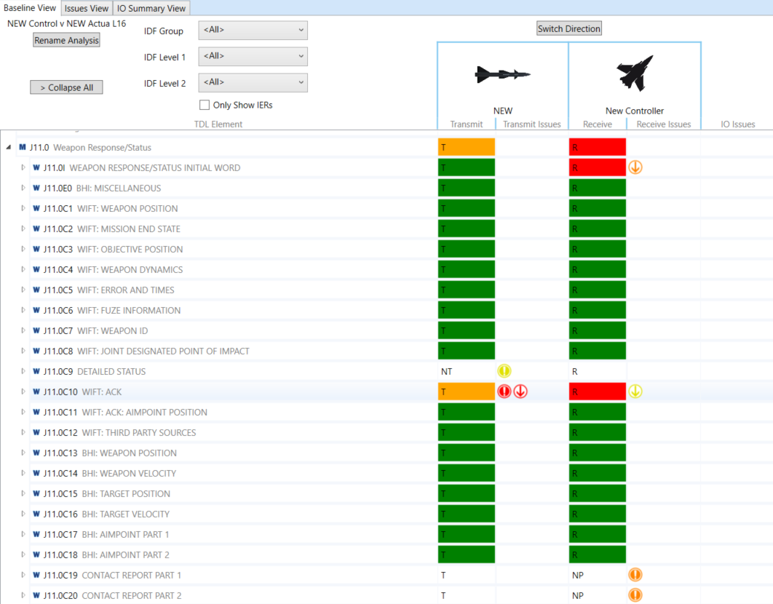
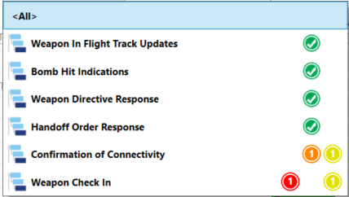
NEW – New Control

Slide 24
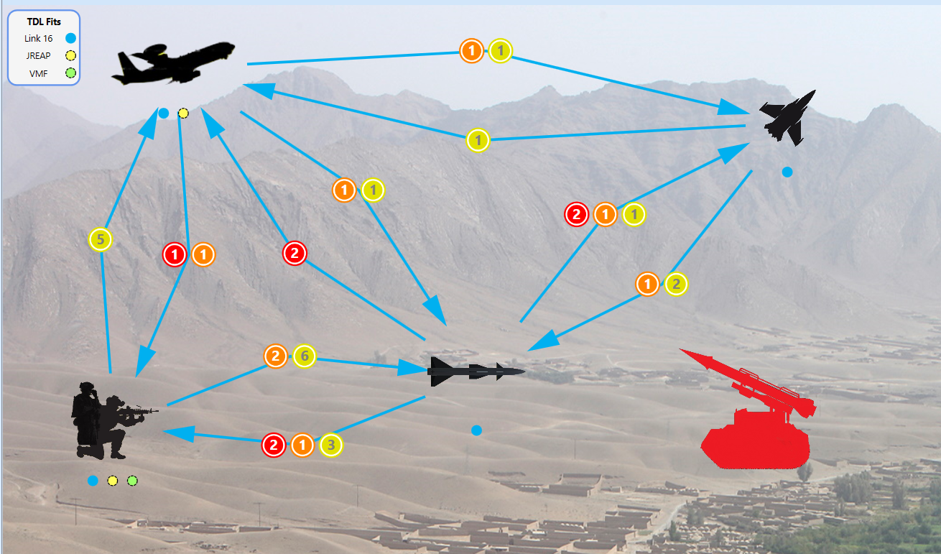
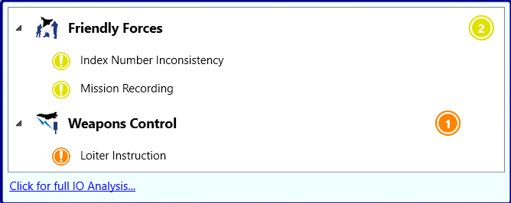
NEW – SoS Caps & Lims

Slide 25
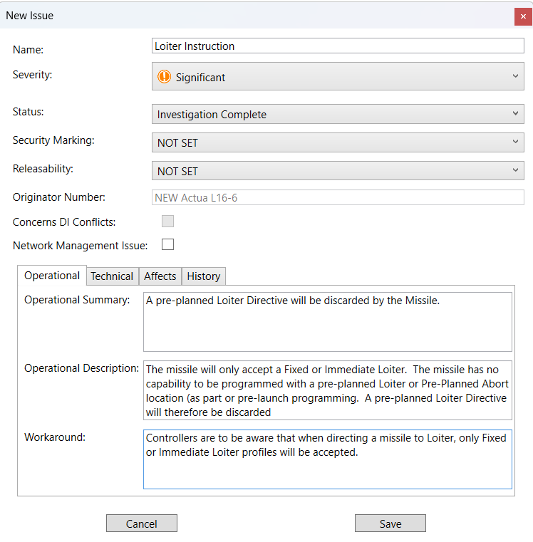
NEW – SoS Caps & Lims

Slide 26
Conclusions
Helping the User Navigate Network Enabled Weapons
Agree which Systems are in scope
Determine Requirements across the entire System of Systems
Understand Mandated vs Optional Options within the Imp Reqs
Ask suppliers for detailed Specification/Implementation Data
Understand System Caps & Lims

Slide 28
Credits
ATDLP-5.16 Edition C Version 1 - March 2021
https://www.mbda-systems.com/product/spear/
https://www.rtx.com/raytheon/what-we-do/sea/joint-standoff-weapon
https://www.kongsberg.com/kda/what-we-do/defence-and-security/missile-systems/joint-strike-missile-jsm/

